Slide 1















fp
HealthCalc:
A Nutritional Analysis Web Application
Presented by Deepak S S

Slide 2
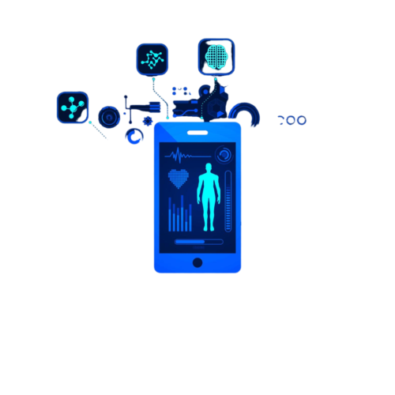
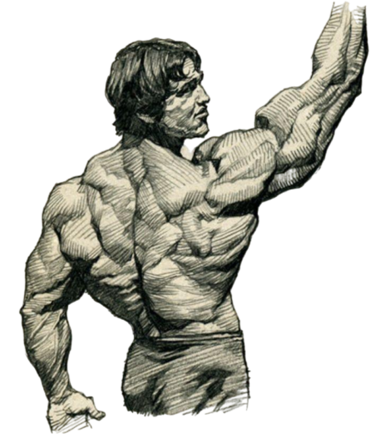
Introduction
HealthCalc is a web-based application that helps users analyze the nutritional content of food items using image recognition and a fine-tuned MobileNetV2 CNN model.
Goal: To provide a convenient and accurate tool for tracking food intake and making informed dietary decisions.

Slide 3
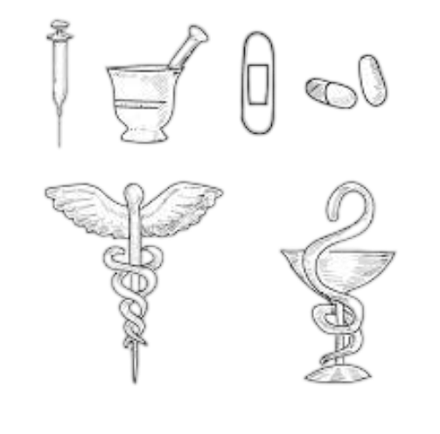
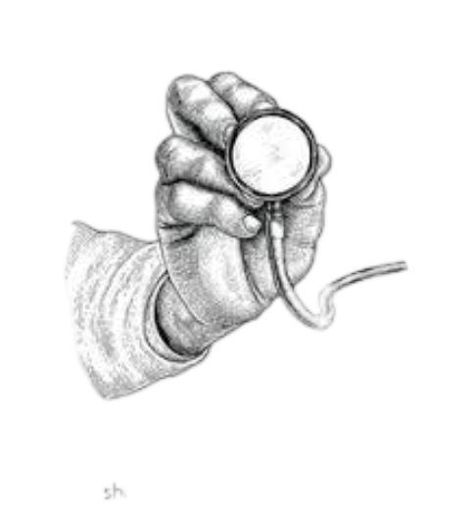
Motivation
Growing health awareness and a demand for easily accessible nutrition information.
Need for fast, accurate food recognition to aid in health monitoring and diet management.
Leverage deep learning to automate nutrition tracking and make it more accessible.

Slide 4

Existing System Limitations
Current apps require manual entry for food items, making tracking tedious.
Limited accuracy in food recognition, with complex user interfaces.
Few apps provide real-time nutritional analysis or use ML models for recognition.

Slide 5
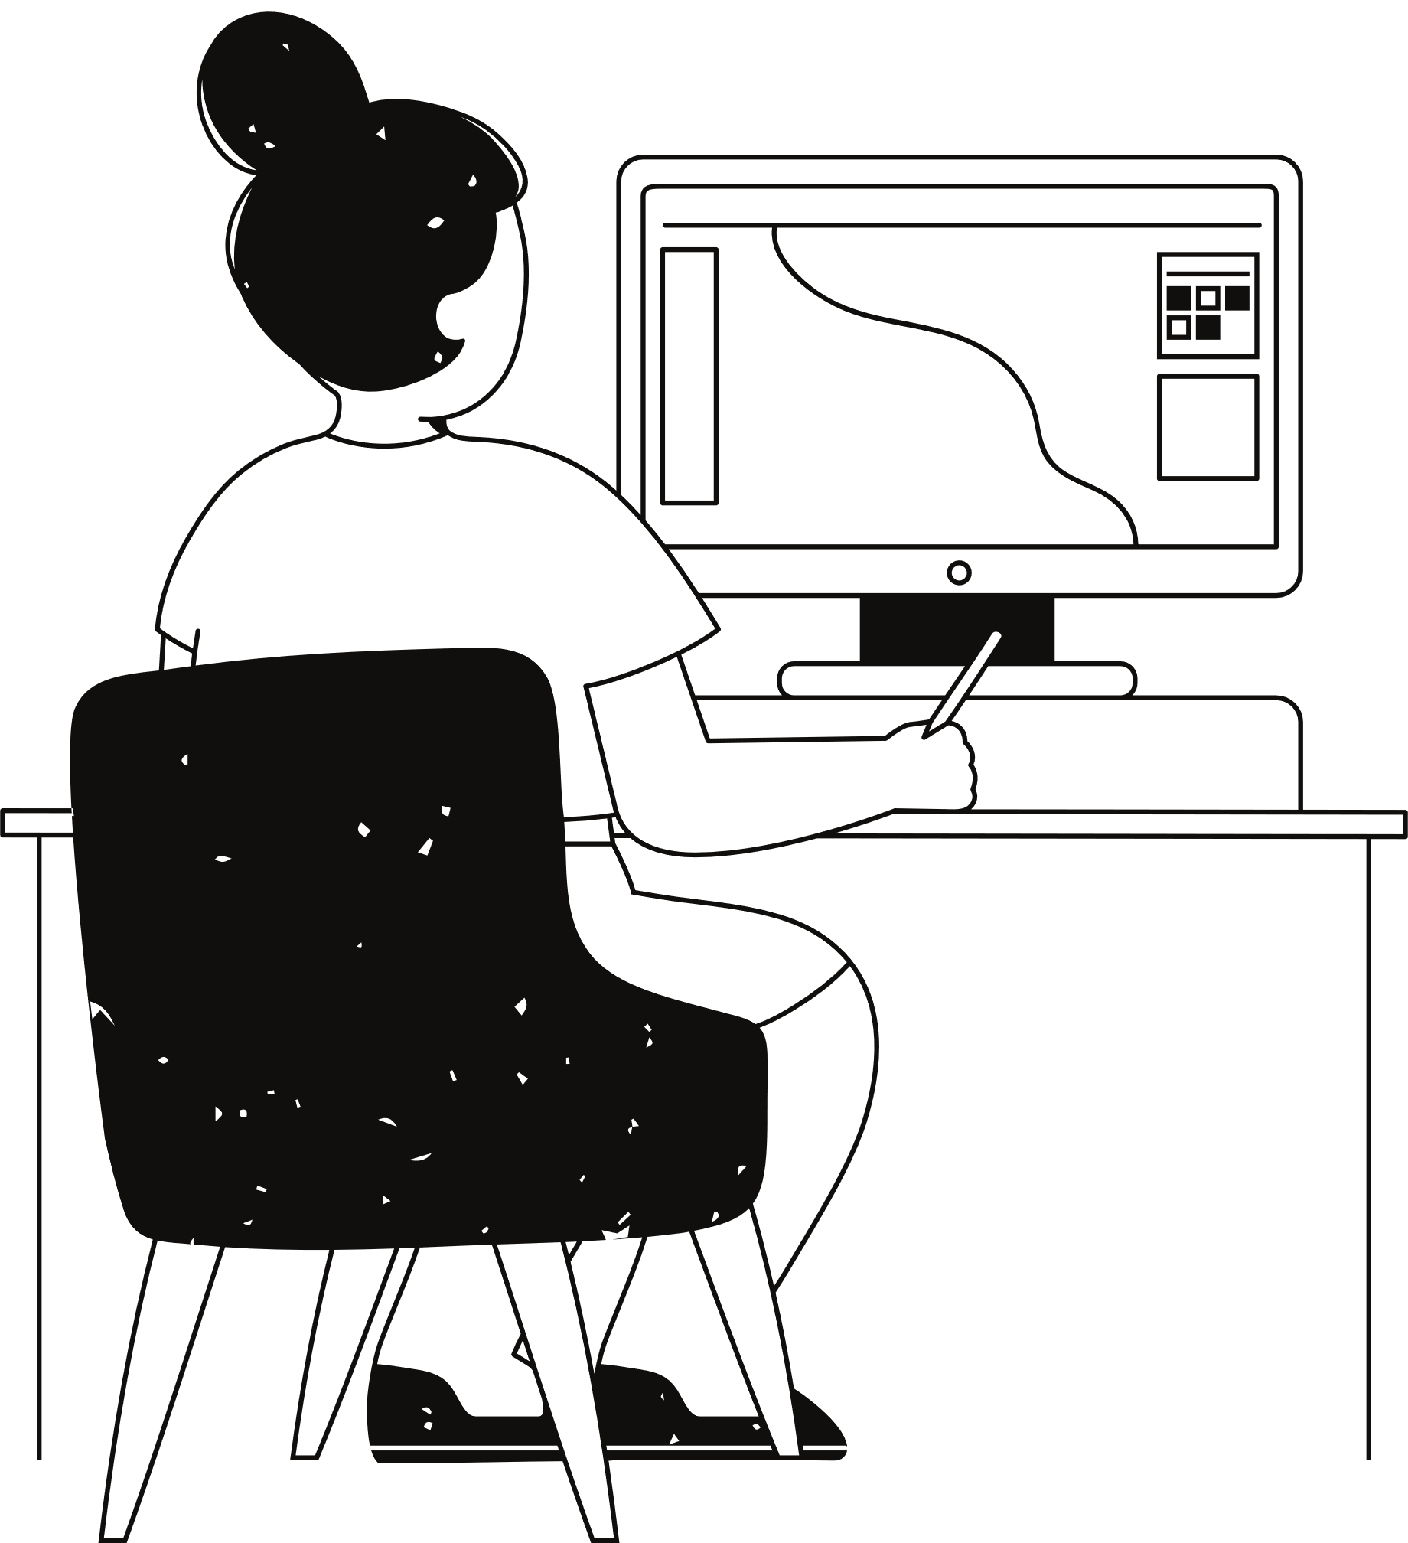
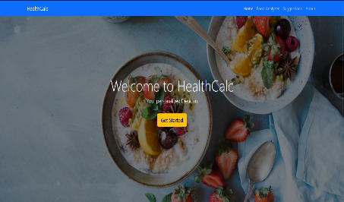
Proposed System & Key Features
Automated Food Recognition: MobileNetV2 provides real-time food item identification.
Nutritional Data Retrieval: Direct access to nutritional information from a CSV database.
User-Friendly Interface: Simple design for easy navigation.
Efficient Architecture: Lightweight and fast backend using Flask.

Slide 6


Slide 7
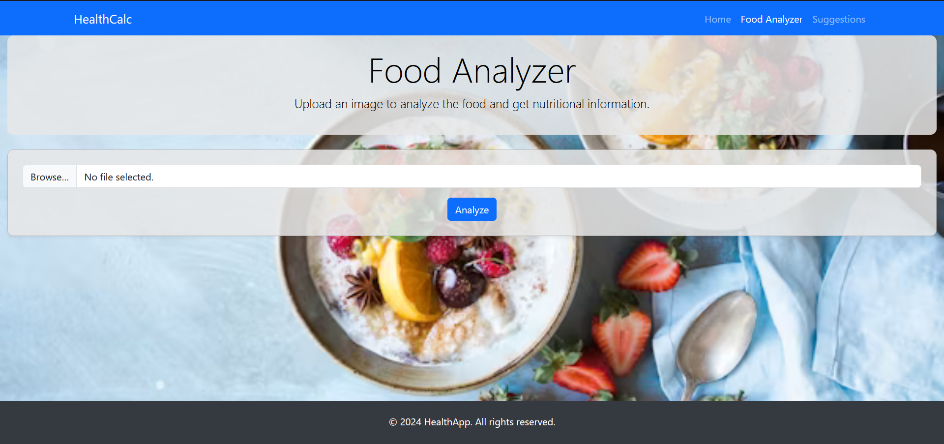

Slide 8
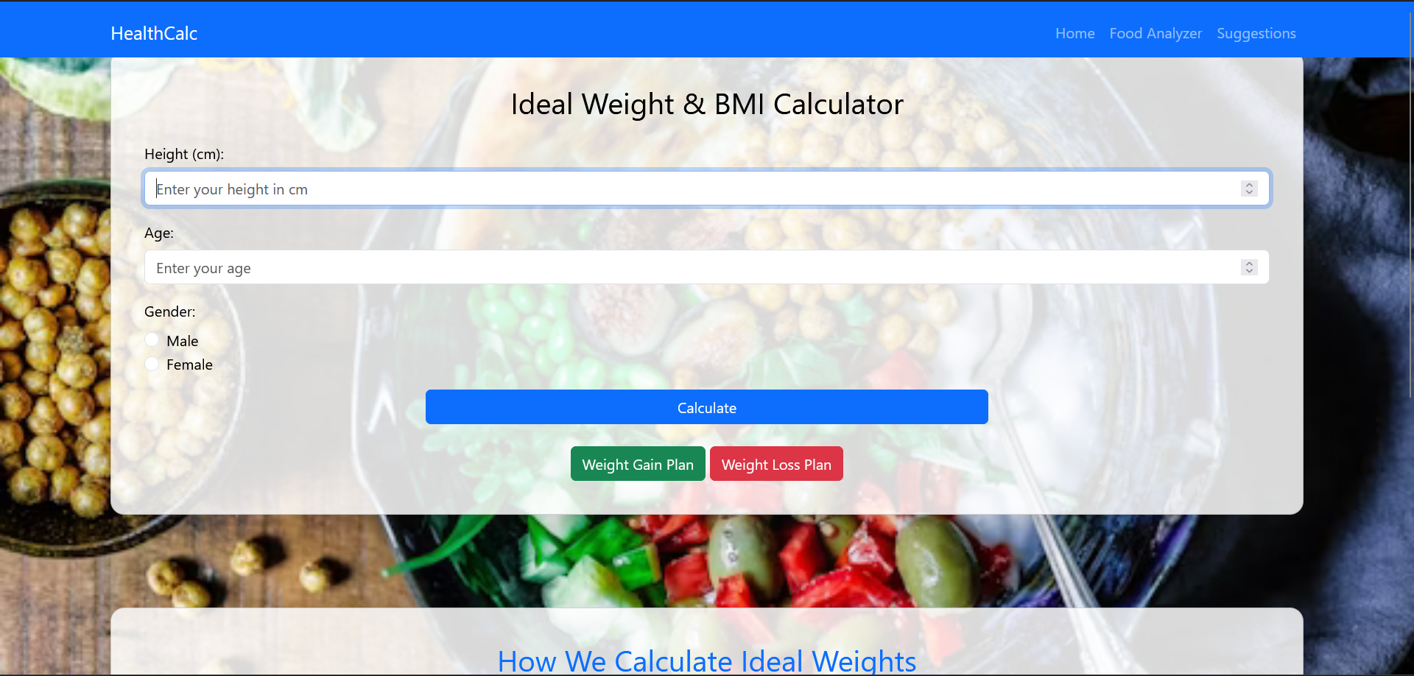

Slide 9
System Architecture
01
02
03
04
User uploads an image of their food.
The image is processed by MobileNetV2, predicting the food item.
The system fetches nutritional data from a CSV file.
Nutritional information is displayed to the user on the interface

Slide 10
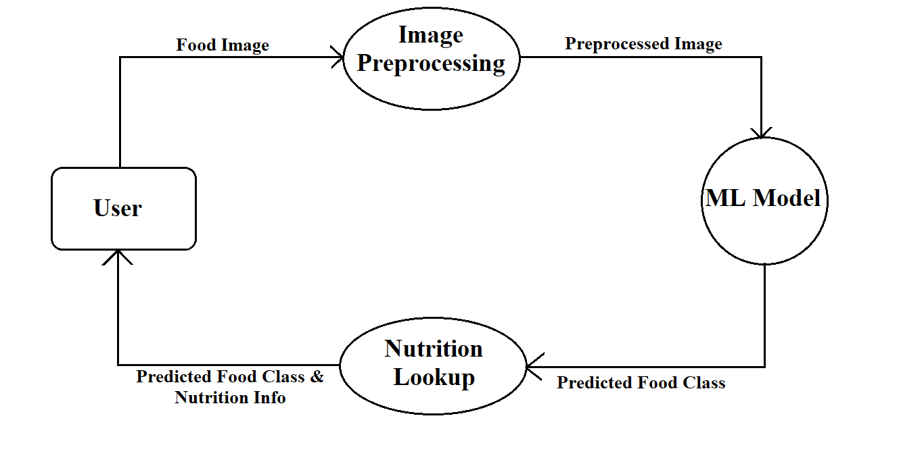
System Architecture

Slide 11
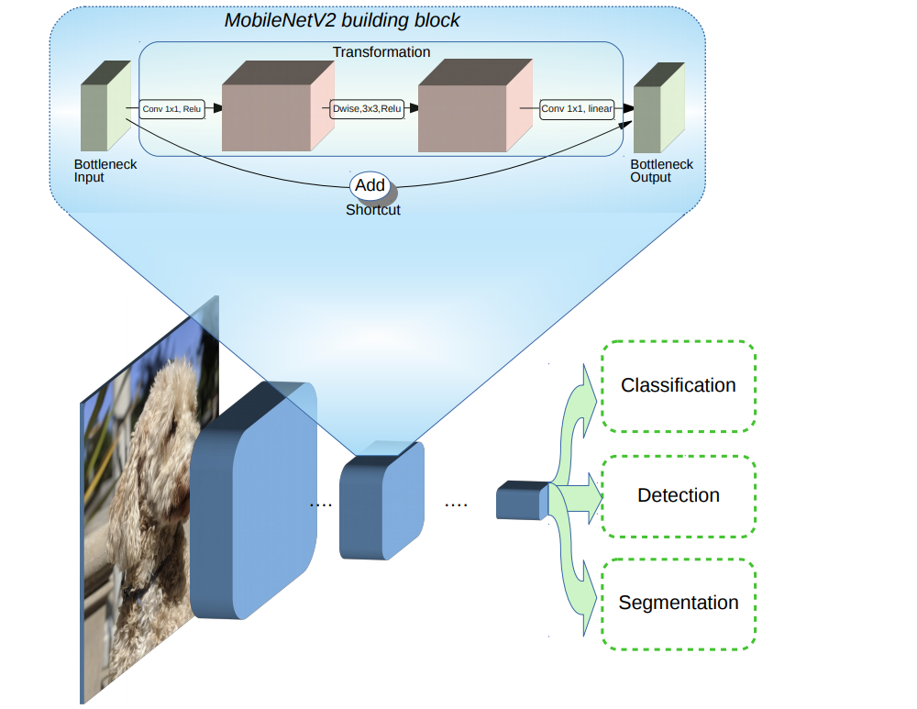
MobileNetV2
Lightweight CNN model optimized for fast and efficient image classification.
Depth wise separable convolutions reduce computation and improve speed.
Inverted residuals and linear bottlenecks enhance performance while maintaining efficiency
Benefits for HealthCalc: Quick food recognition suitable for real-time applications

Slide 12
89%
Fine-tuned Model Accuracy
Achieved an accuracy of over 89% on the test set, with reliable predictions across various food categories.

Slide 13

Unit Testing
Integration Testing
Verified individual functions like image upload, model prediction, and data retrieval.
Ensured seamless interaction between all components.
Model Performance Testing
Response Time
Assessed MobileNetV2's accuracy, precision, and response time.
Average response time to ensuring a smooth user experience.

Slide 14
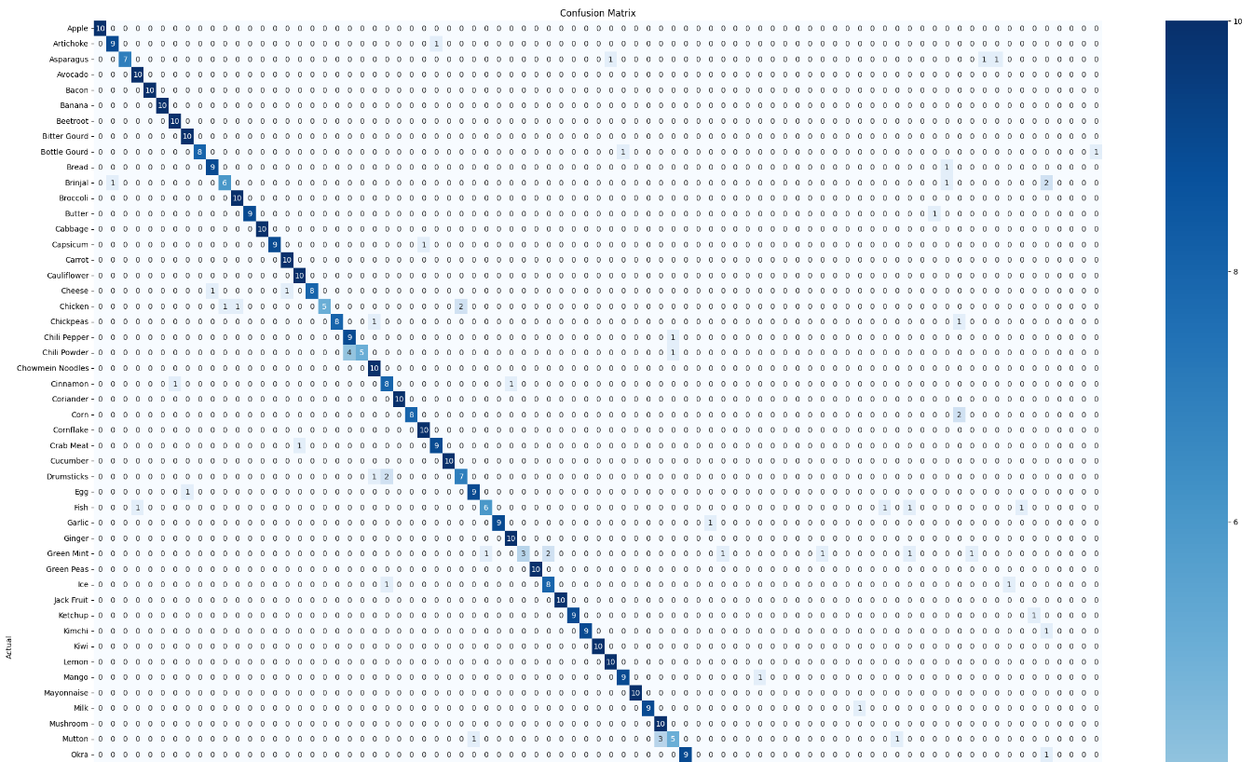
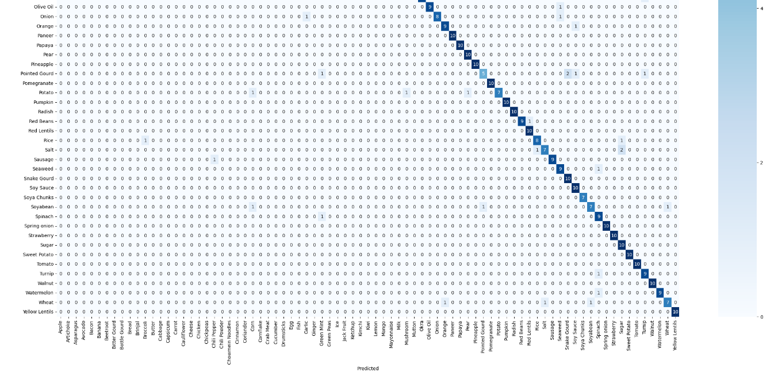
Confusion Matrix

Slide 15

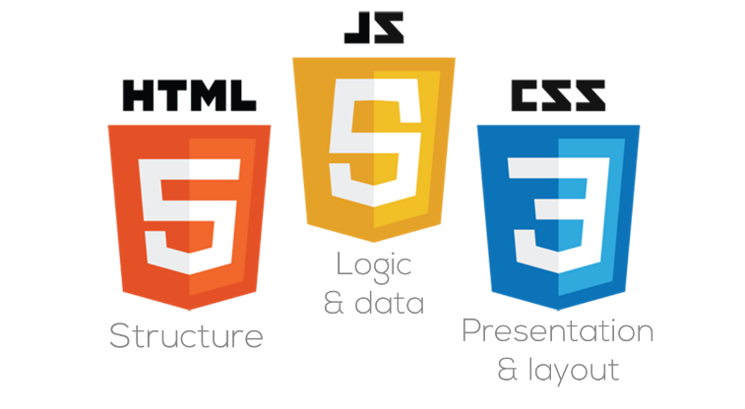



Frontend
Backend
Flask framework (Python) for handling requests and responses.
HTML, CSS, JavaScript for the user interface.
Technology Stack
HealthCalc
Machine Learning:
Data Storage
MobileNetV2 model, optimized with TensorFlow/Keras for food classification.
Nutritional information stored in a CSV file.

Slide 16
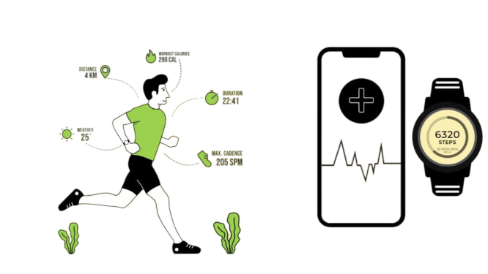
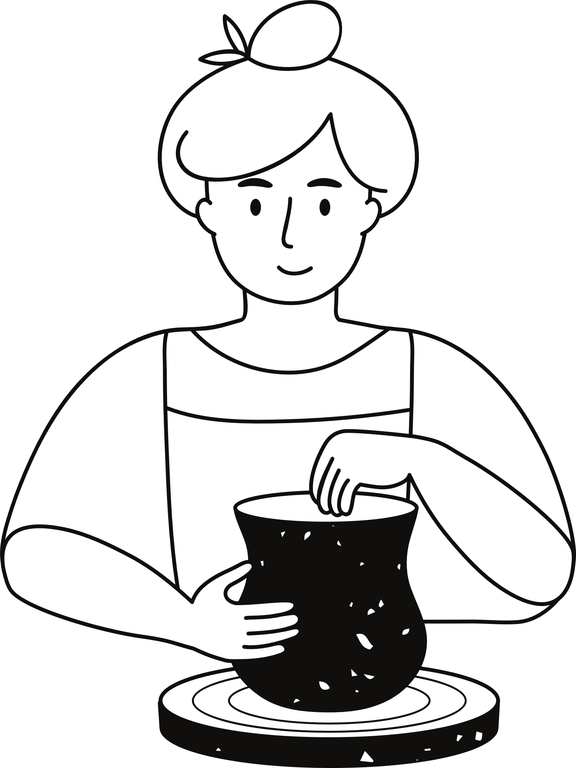


Conclusion and Future Scope
HealthCalc simplifies nutritional analysis with machine learning, providing users with an accessible tool for food tracking
Expand database to cover more food items and cuisines.
Add user profiles for personalized tracking and diet recommendations.
Develop a mobile version for on-the-go analysis.
Integrate with wearables for real-time monitoring.

Slide 17
Thank you very much!
Deepak

